Slide 1

Spark
1
Notes:
1

Slide 2
Apache Spark
Open Source framework.
Cluster computing framework for large-scale data processing.
Supports all distributed file systems.

Slide 3
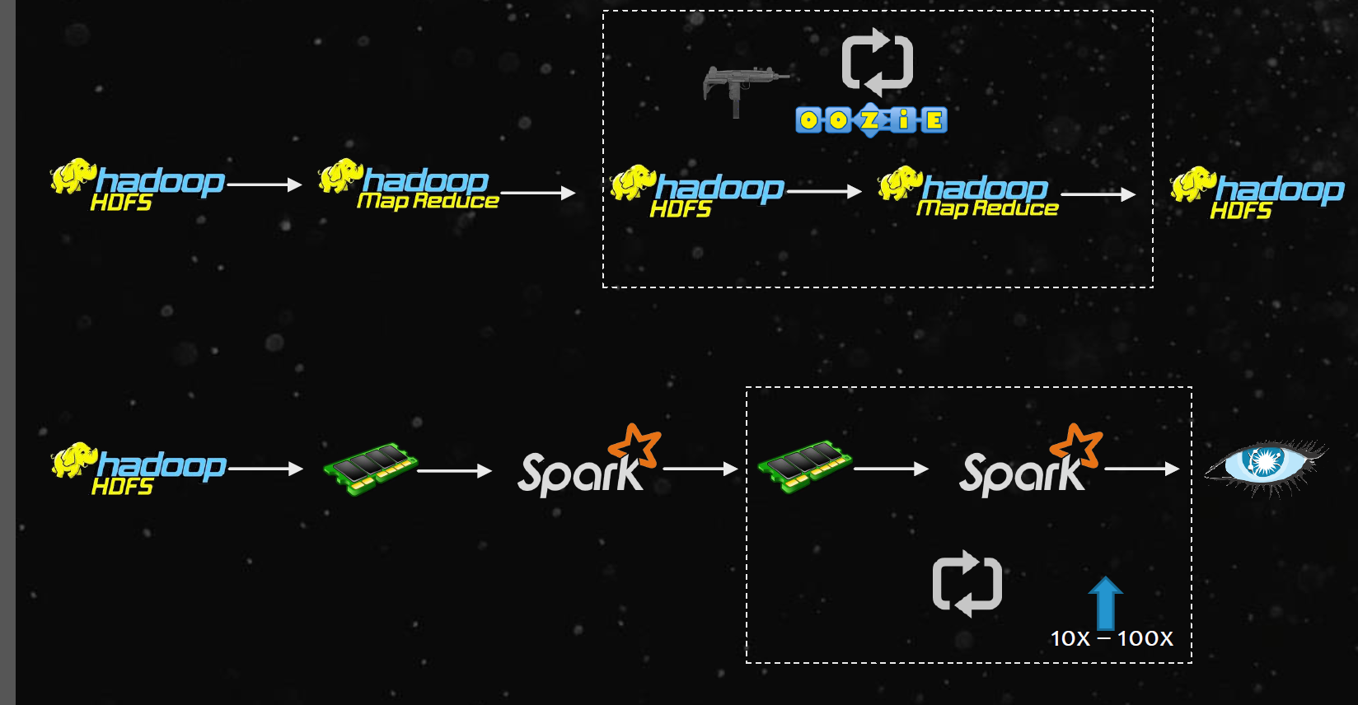

Slide 4
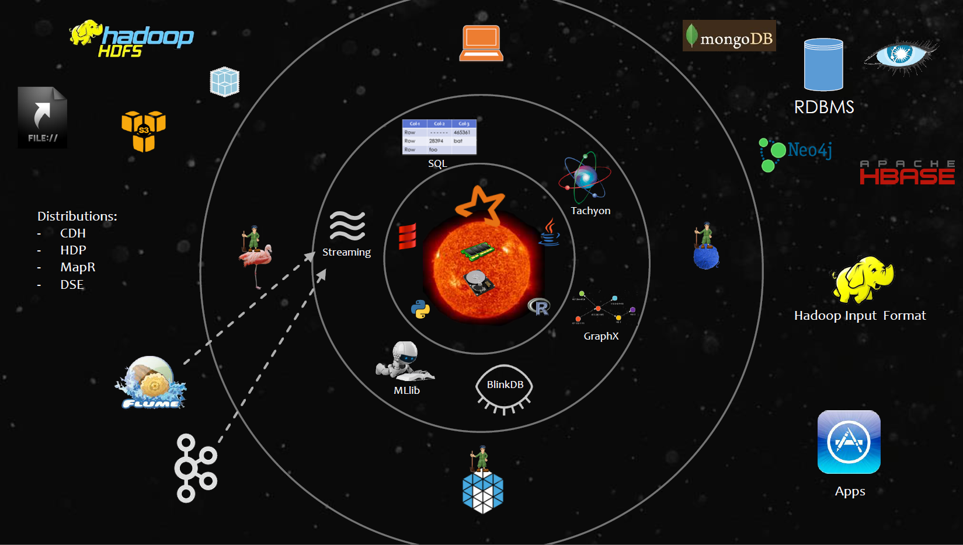
Spark Core

Slide 5
spark core
Benefits of spark
speed:
Spark core used both disk and memory while processing the data
-- >Run programs up to 100x faster than Hadoop MapReduce in memory, or 10x faster on disk.
-- > Spark has an advanced DAG (Directed Acyclic Graph) execution engine
Easy of use:
-- > Write the code in Java, Scala, python,sql etc..
-- > Support traditional APIs java, scala, python, experimental R and DataFrames

Slide 6
spark core
A Unified Engine:
-- > Spark comes packaged with higher-level libraries
spark SQL – structured data
spark streaming – way to analyze the real time data
Mlib – machine learning
GraphX

Slide 7
spark core
Resource Managers
Coordinators running in the execution of spark
-- > Local mode
-- > Standalone mode
-- > YARN mode
-- > Mesos
File systems:
Almost it can read the data from any file system like
local ext3, ext4, amazon s3 , HDFS
Supports NoSQL databases:
like Apache HBASE , mongo DB, RDBMS
Distributions:
CDH,HDP,MapR,IBM BigInsight etc….

Slide 8
Resilient Distributed Dataset (RDD)
Represents a read-only collection of objects partitioned across a set of machines.
Users can explicitly cache an RDD in memory across machines and reuse.
RDDs achieve fault tolerance through a notion of lineage.

Slide 9
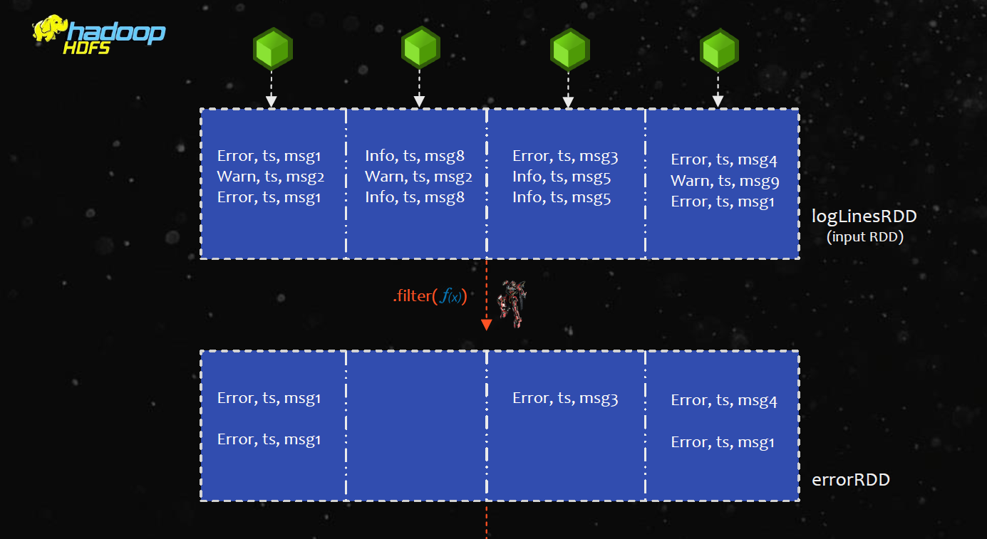

Slide 10
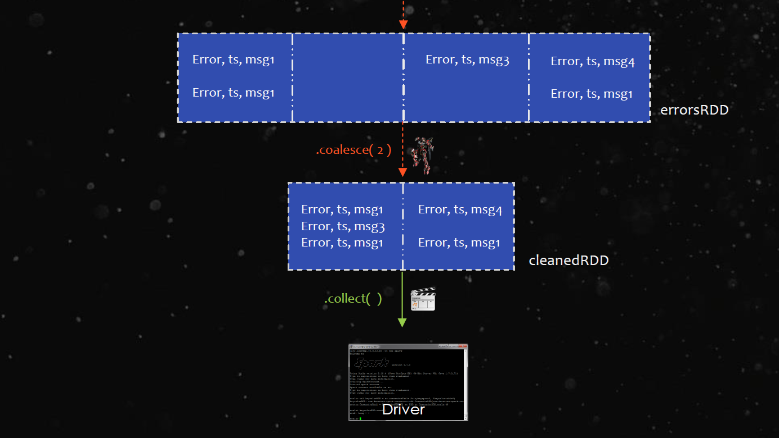

Slide 11
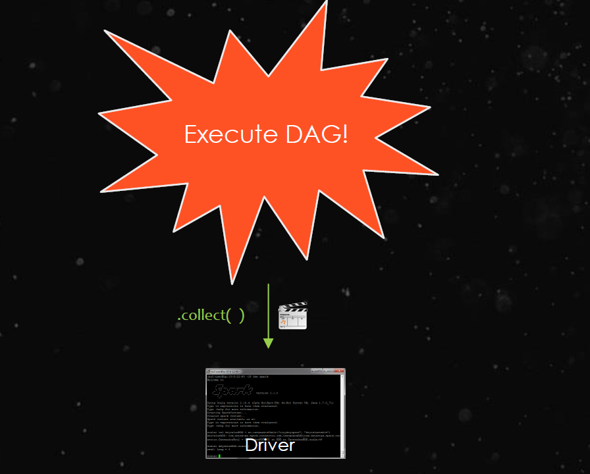

Slide 12
Cached RDD
RDD.unpersist()
RDD.unpersist()
rdd.cache()
Cached RDDs can be retrieved only by jobs in the same application.
Spark automatically monitors cache usage on each node and drops out old data partitions in a least-recently-used (LRU) fashion
Manually remove using RDD.unpersist() method

Slide 13
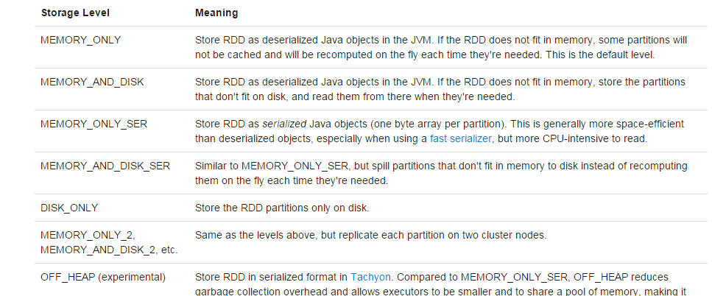
Memory and Persistance

Slide 14
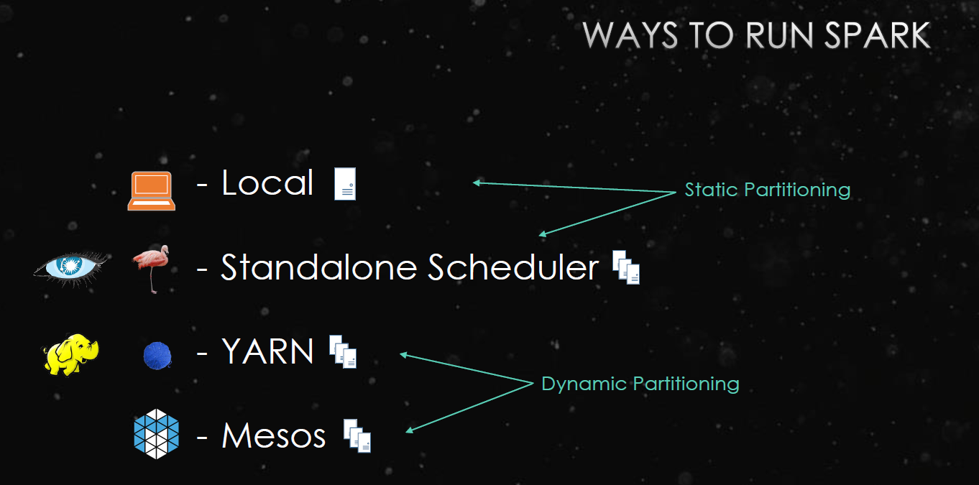
Spark execution in diff modes

Slide 15
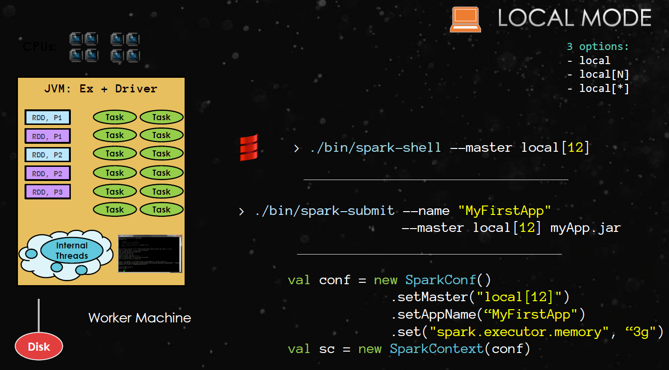

Slide 16
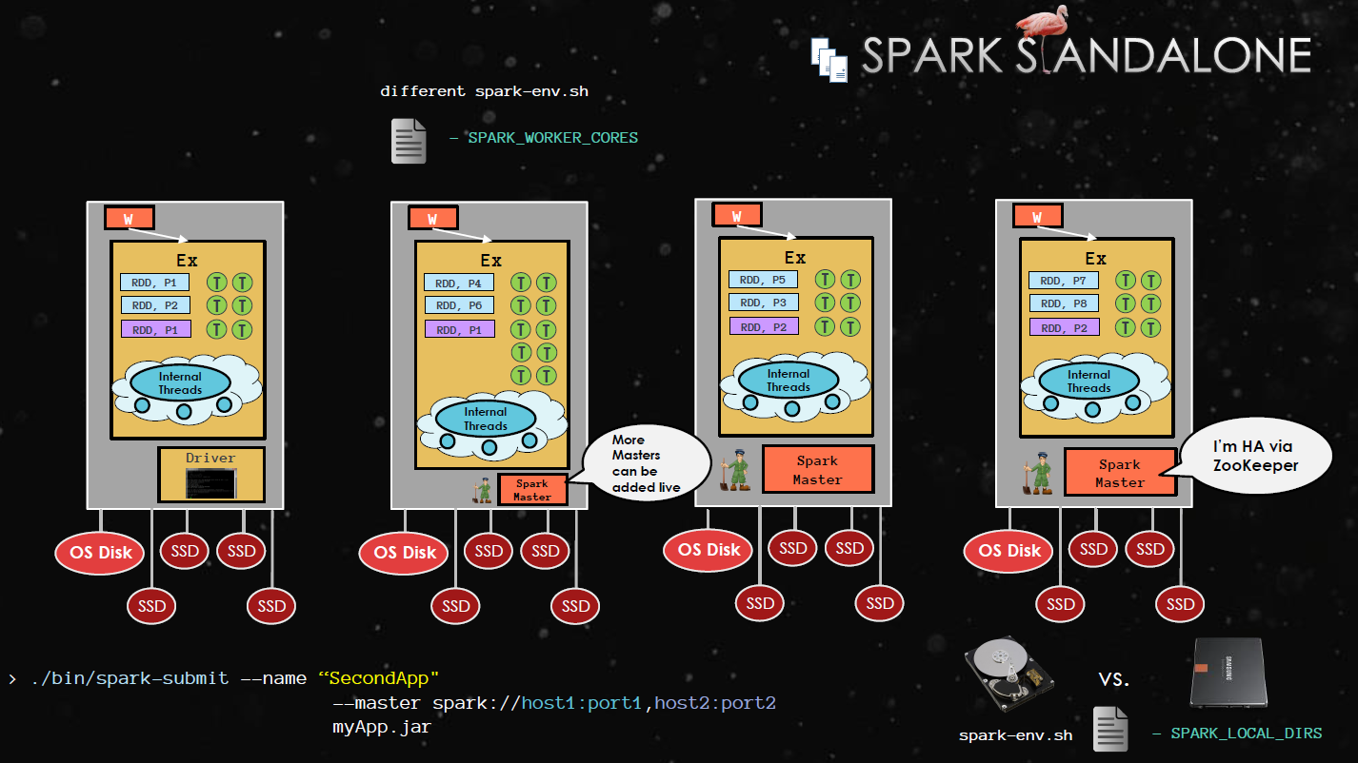

Slide 17
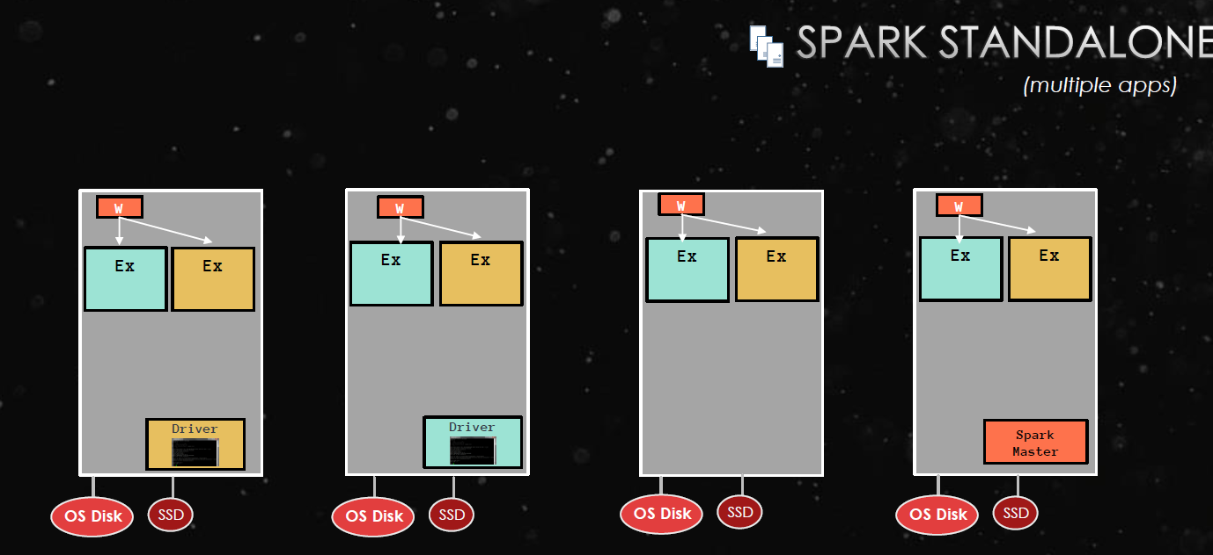

Slide 18
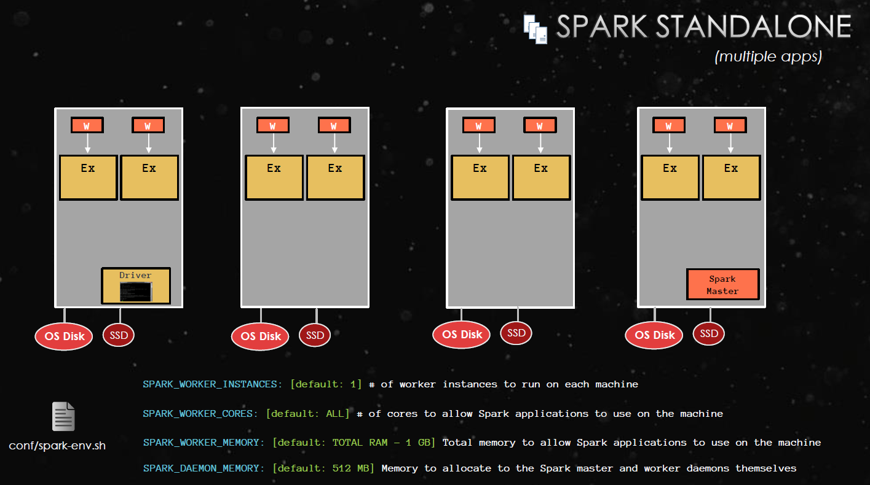

Slide 19
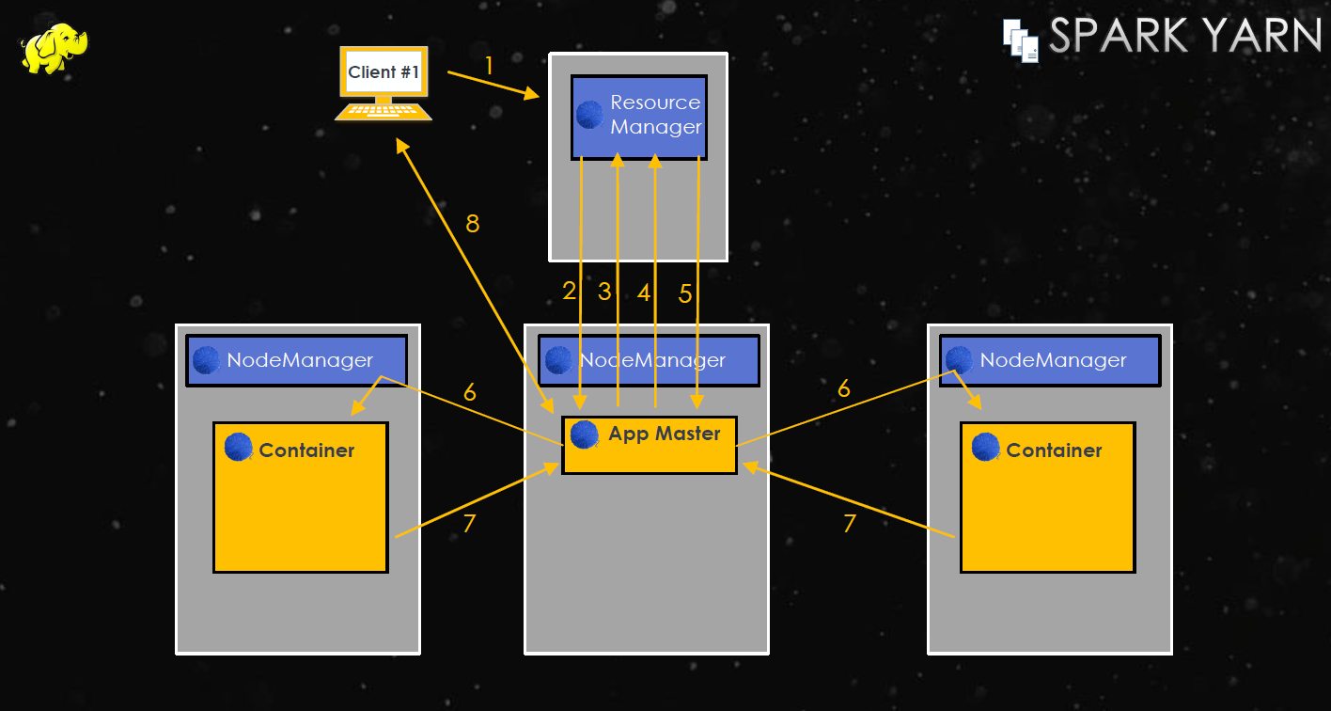
Spark YARN mode

Slide 20
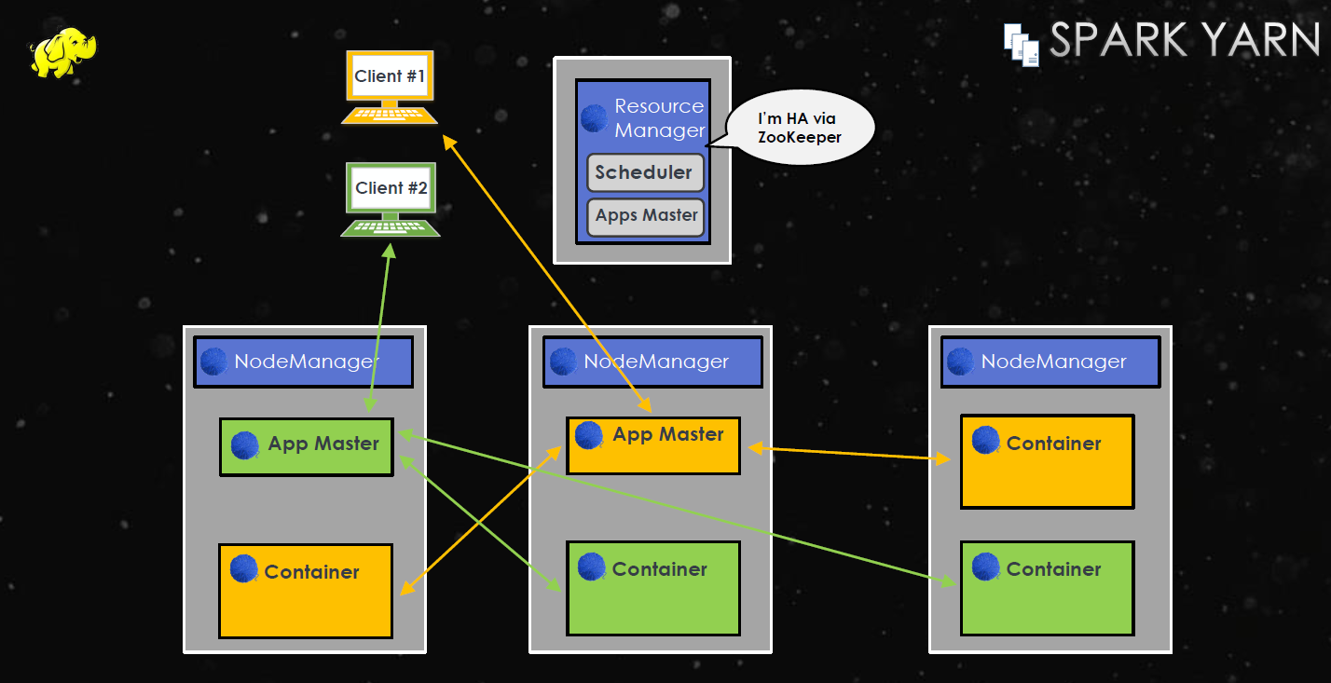
Spark YARN mode

Slide 21
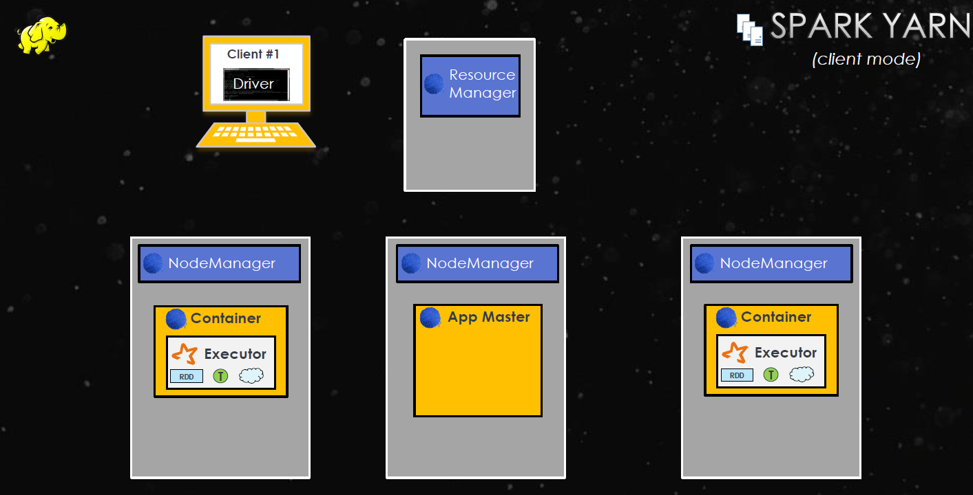
Spark YARN (client mode)

Slide 22
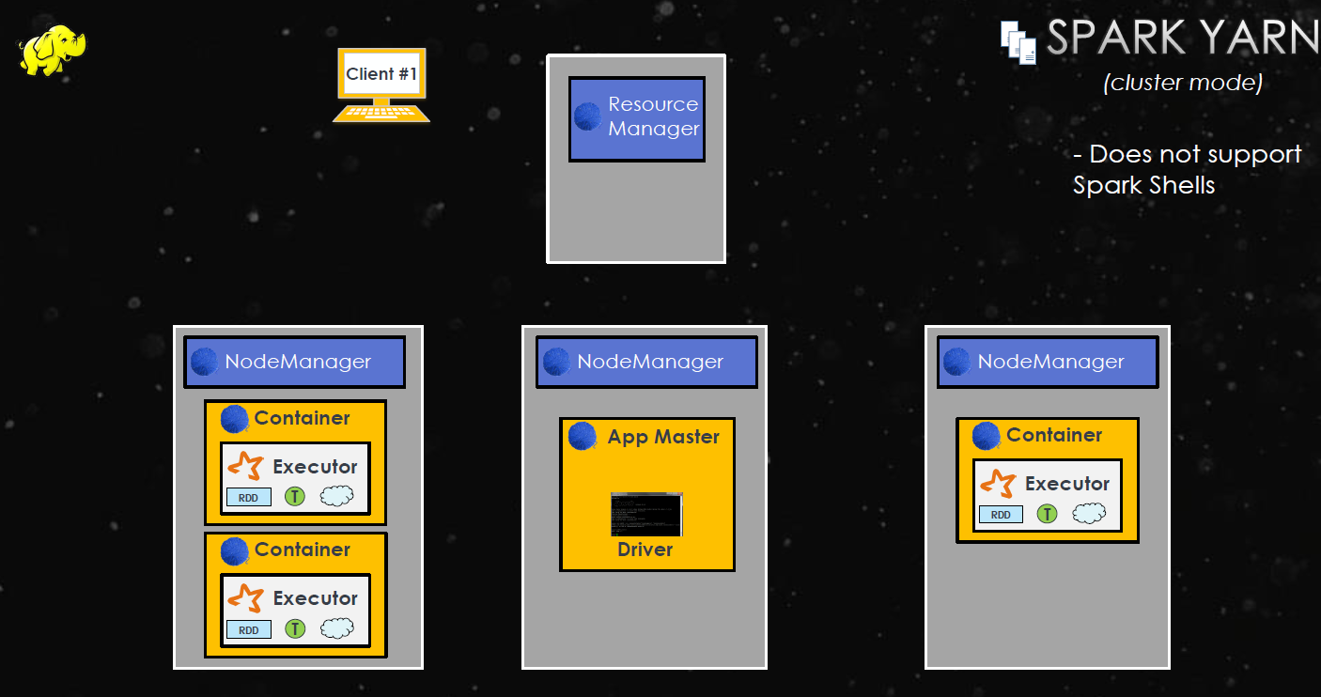
Spark YARN (client mode)

Slide 23


Slide 24
DRIVER
The driver is the process where the main method runs. First it converts the user program into tasks and after that it schedules the tasks on the executors.

Slide 25
EXECUTORS
Executors are worker nodes' processes in charge of running individual tasks in a given Spark job. They are launched at the beginning of a Spark application and typically run for the entire lifetime of an application. Once they have run the task they send the results to the driver. They also provide in-memory storage for RDDs that are cached by user programs through Block Manager.

Slide 26
Diff modes
The Spark standalone mode requires each application to run an executor on every node in the cluster; whereas with YARN, you choose the number of executors to use.

Slide 27
Client mode
Want to get a job result (dynamic analysis)
Easier for developing/debugging
Control where your Driver Program is running
Always up application: expose your Spark job launcher as REST service or a Web UI
Cluster mode
Easier for resource allocation (let the master decide): Fire and forget
Monitor your Driver Program from Master Web UI like other workers
Stop at the end: one job is finished, allocated resources are freed

Slide 28
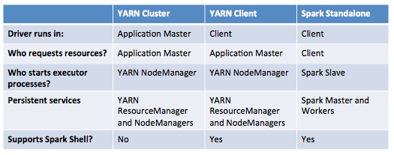

Slide 29
Spark-Streaming
Dstream-discretized stream, continuous stream of data.
Internally DStream is represented as a sequence of RDDs

Slide 30
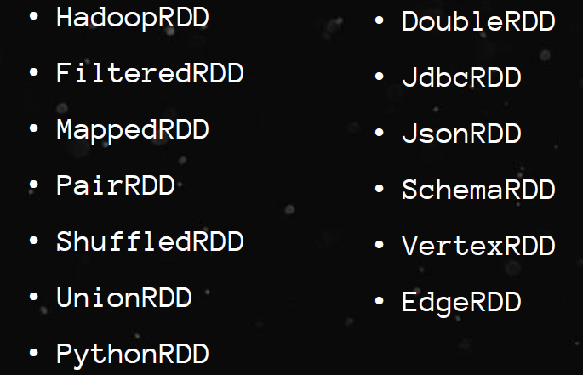
Types of RDDs

Slide 31
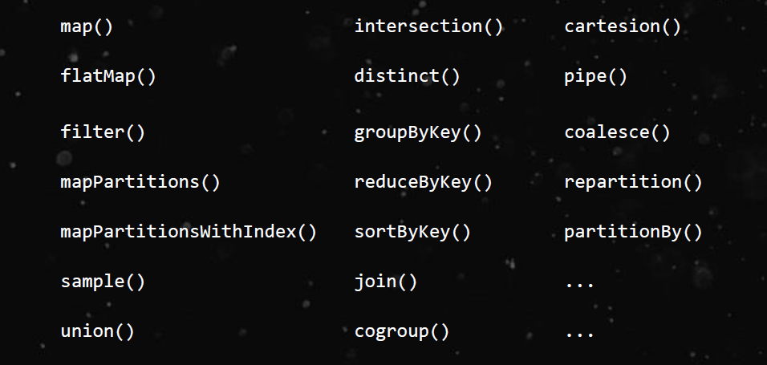
Transformations(lazy)

Slide 32
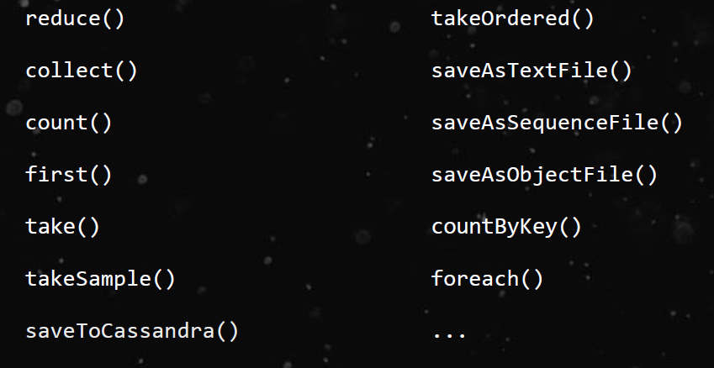
Actions

Slide 33
Shared Variables
Broadcast Variable
-- > to reduce communication cost,allow the programmer to keep a read-only variable cached on each machine rather than shipping a copy of it with tasks.
ex: Broadcast <int[]> broadcastVar = sc.broadcast(new int[]{1,2,3});
broadcastVar.value();
Accumulators:
Can be used to count the # of errors seen in an RDD of lines spread across 100s of nodes.
-- > final Accumulator<Integer> count = sc.accumulator(0);
count.add();

Slide 34
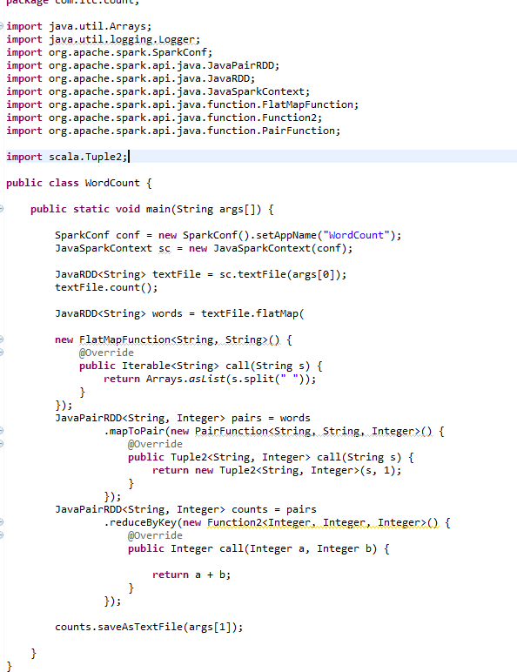
Word count example

Slide 35
Thank You !

